Slide 1

ICT Project Management
Surendra K.C.

Slide 2


Slide 3


Slide 4
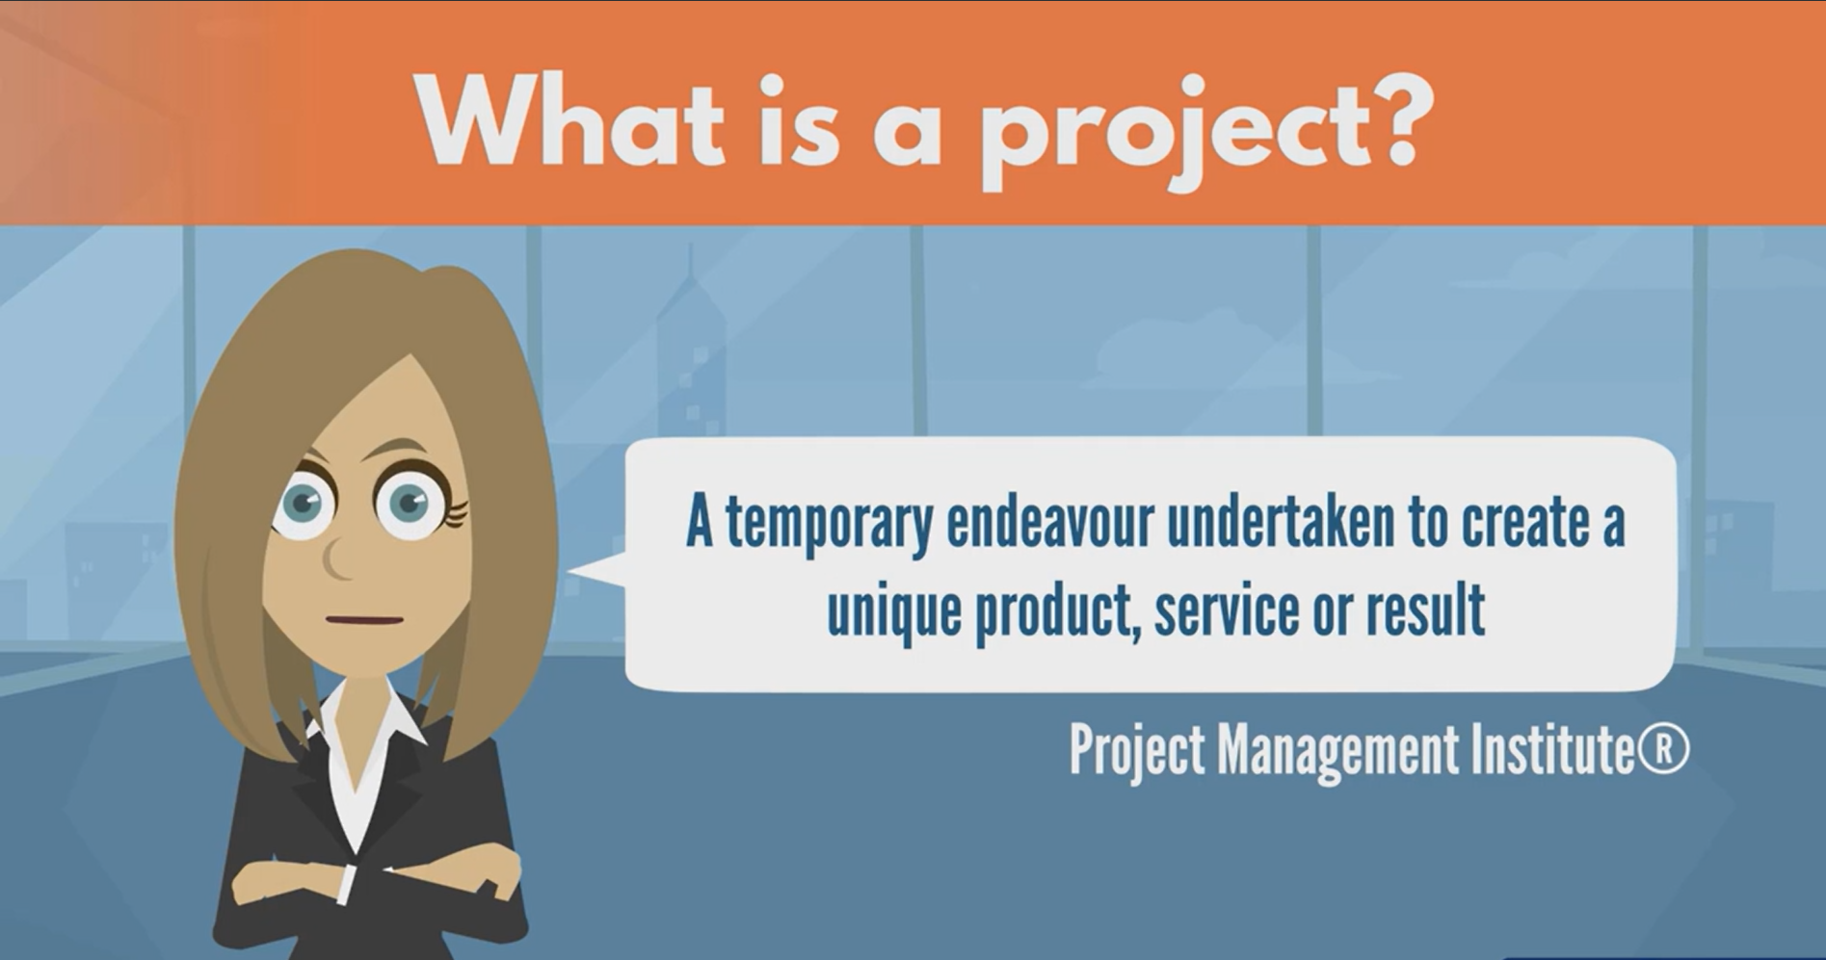

Slide 5


Slide 6


Slide 7


Slide 8
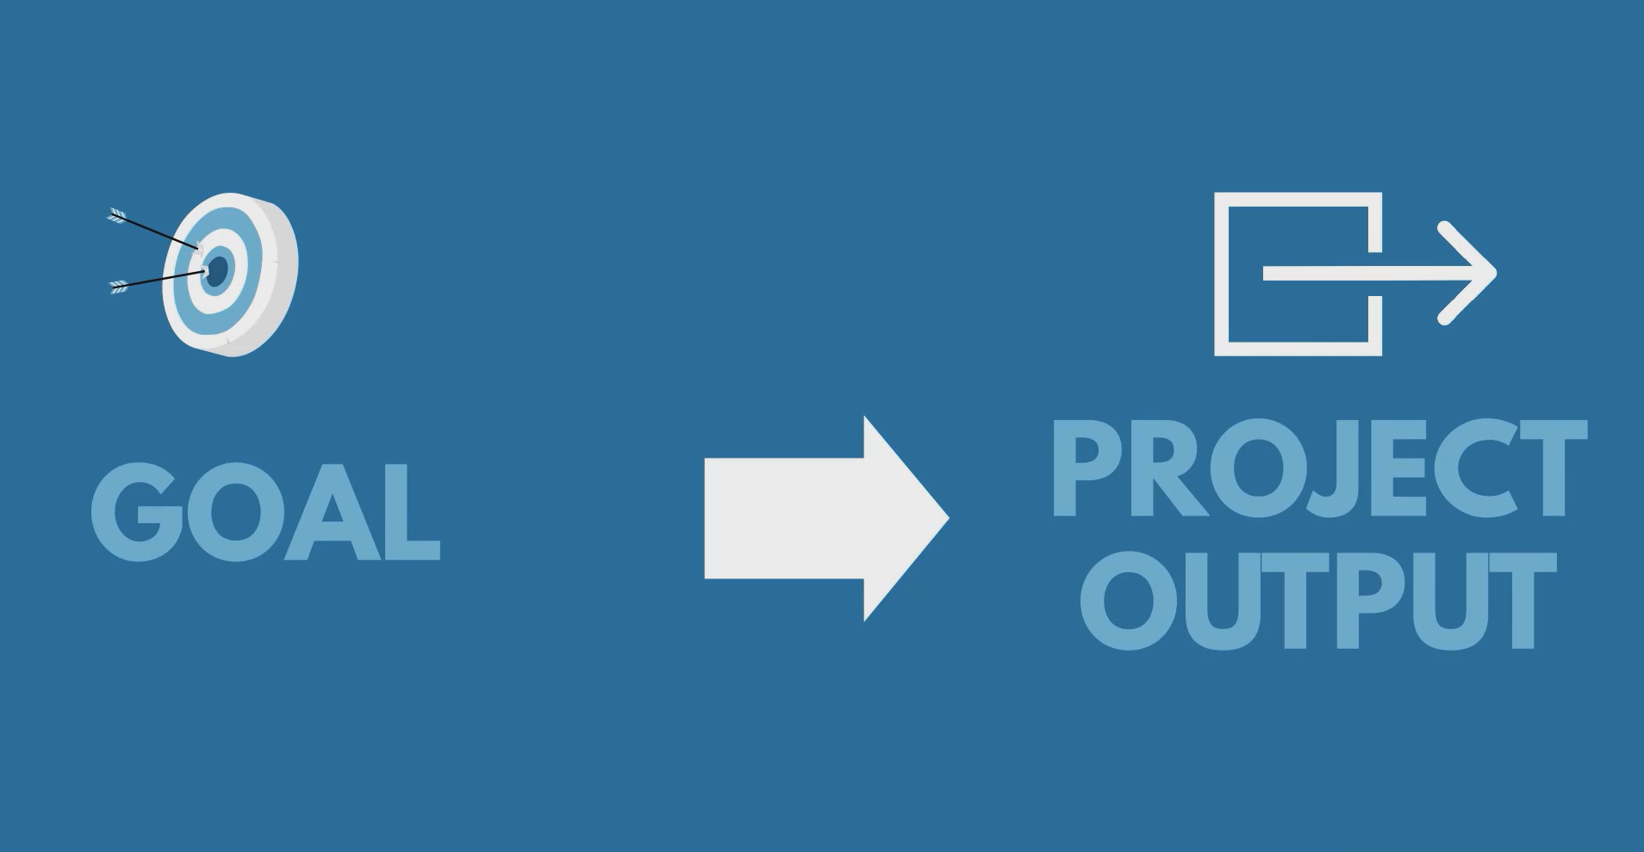

Slide 9
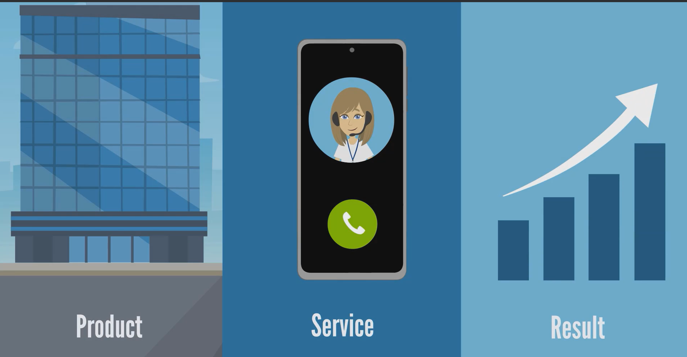

Slide 10
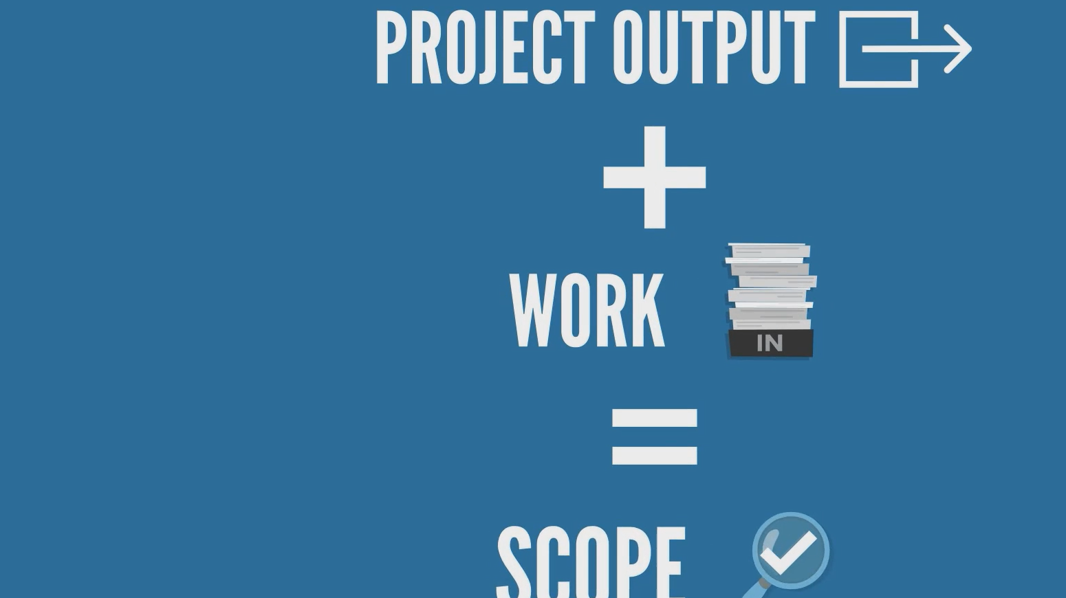

Slide 11


Slide 12


Slide 13


Slide 14
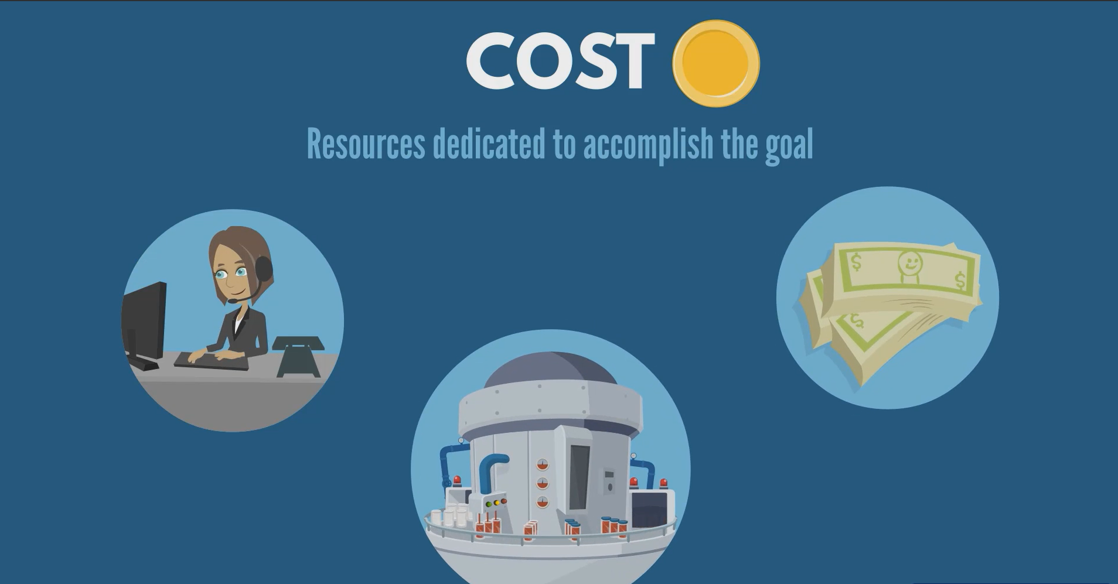

Slide 15
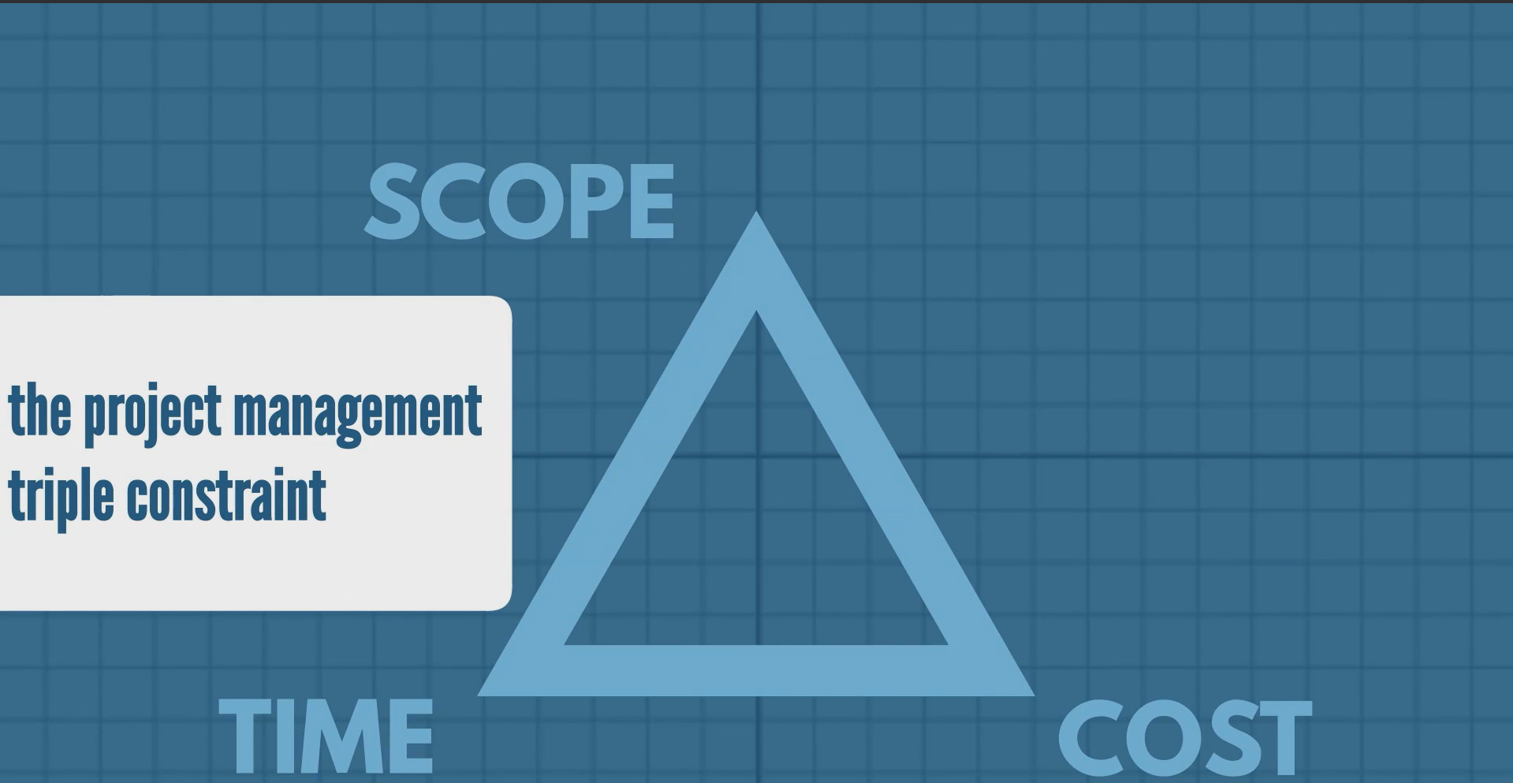

Slide 16


Slide 17


Slide 18


Slide 19
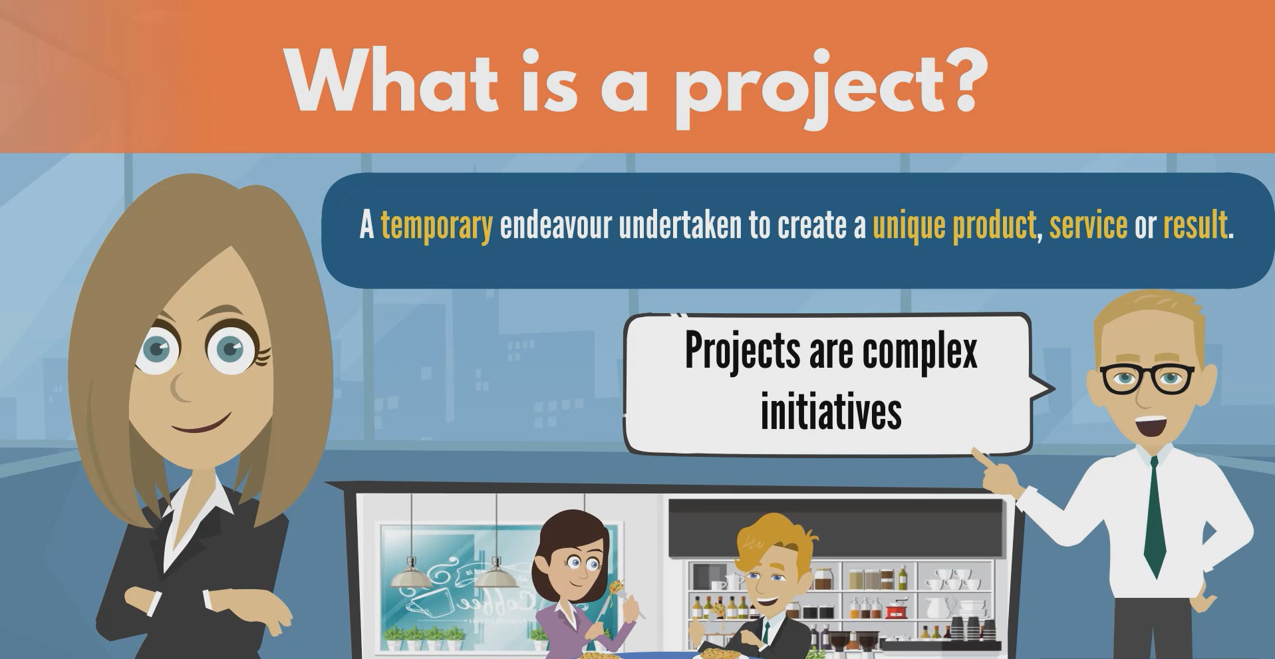

Slide 20
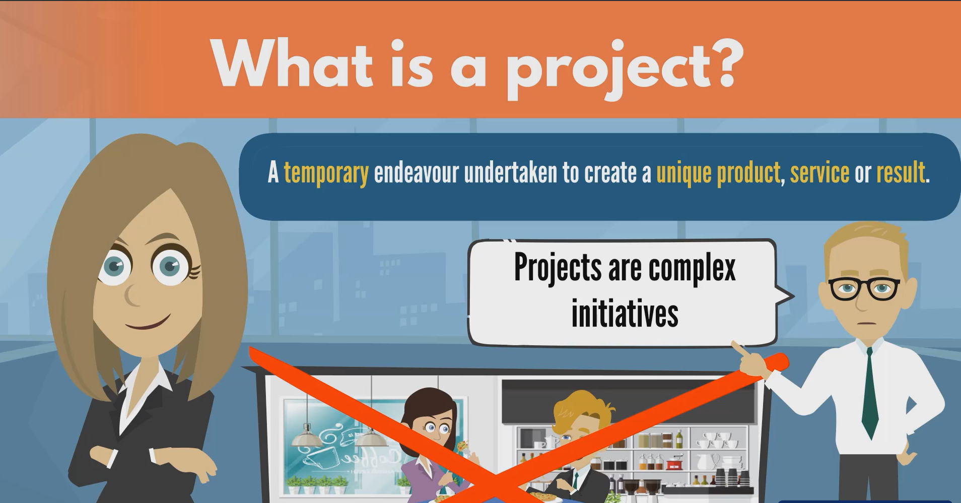

Slide 21
The term "project" can have different meanings depending on the context, but in a general sense, a project is a temporary endeavor with a specific goal or set of goals that is undertaken to create a unique product, service, or result. Projects are typically characterized by their defined scope, specific start and end dates, and allocation of resources.
Temporary Nature: A project has a definite beginning and end. Once the project's goals are achieved or the project is deemed unfeasible, it is closed.
Unique Objectives: Projects are distinct from routine operations because they are focused on achieving specific objectives. These objectives could be creating a product, implementing a system, conducting research, or delivering a service.
Defined Scope: Projects have well-defined boundaries or scope that outlines what is included in the project and what is not. This helps in managing expectations and resources.
Allocated Resources: Projects require the allocation of various resources, including people, time, money, and equipment, to achieve their goals.
Cross-Functional Teams: Projects often involve individuals from different departments or disciplines who come together to work on the project and bring their unique expertise.
Project Management: The process of planning, executing, and closing a project is known as project management. It involves managing resources, schedules, budgets, risks, and communication to ensure the successful completion of the project.
Examples of projects could include developing a new software application, constructing a building, organizing an event, conducting a research study, or implementing a new business process.
In a software development context, a "project" could refer to a specific set of tasks and activities aimed at creating a software product or system

Slide 22
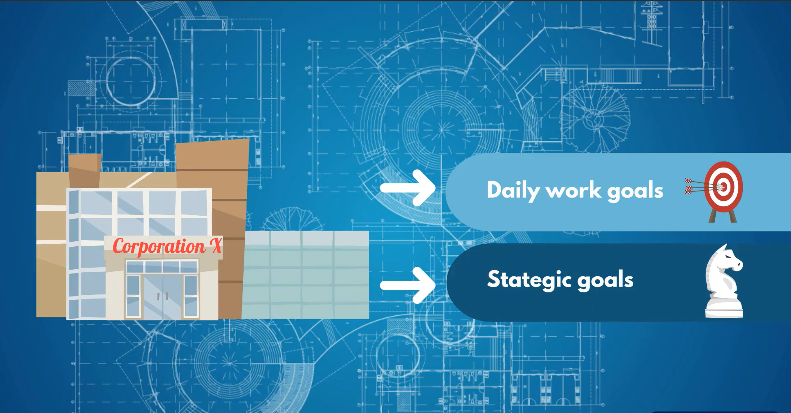

Slide 23
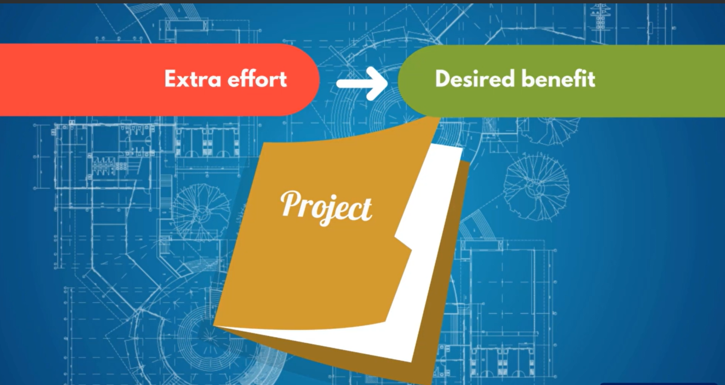

Slide 24
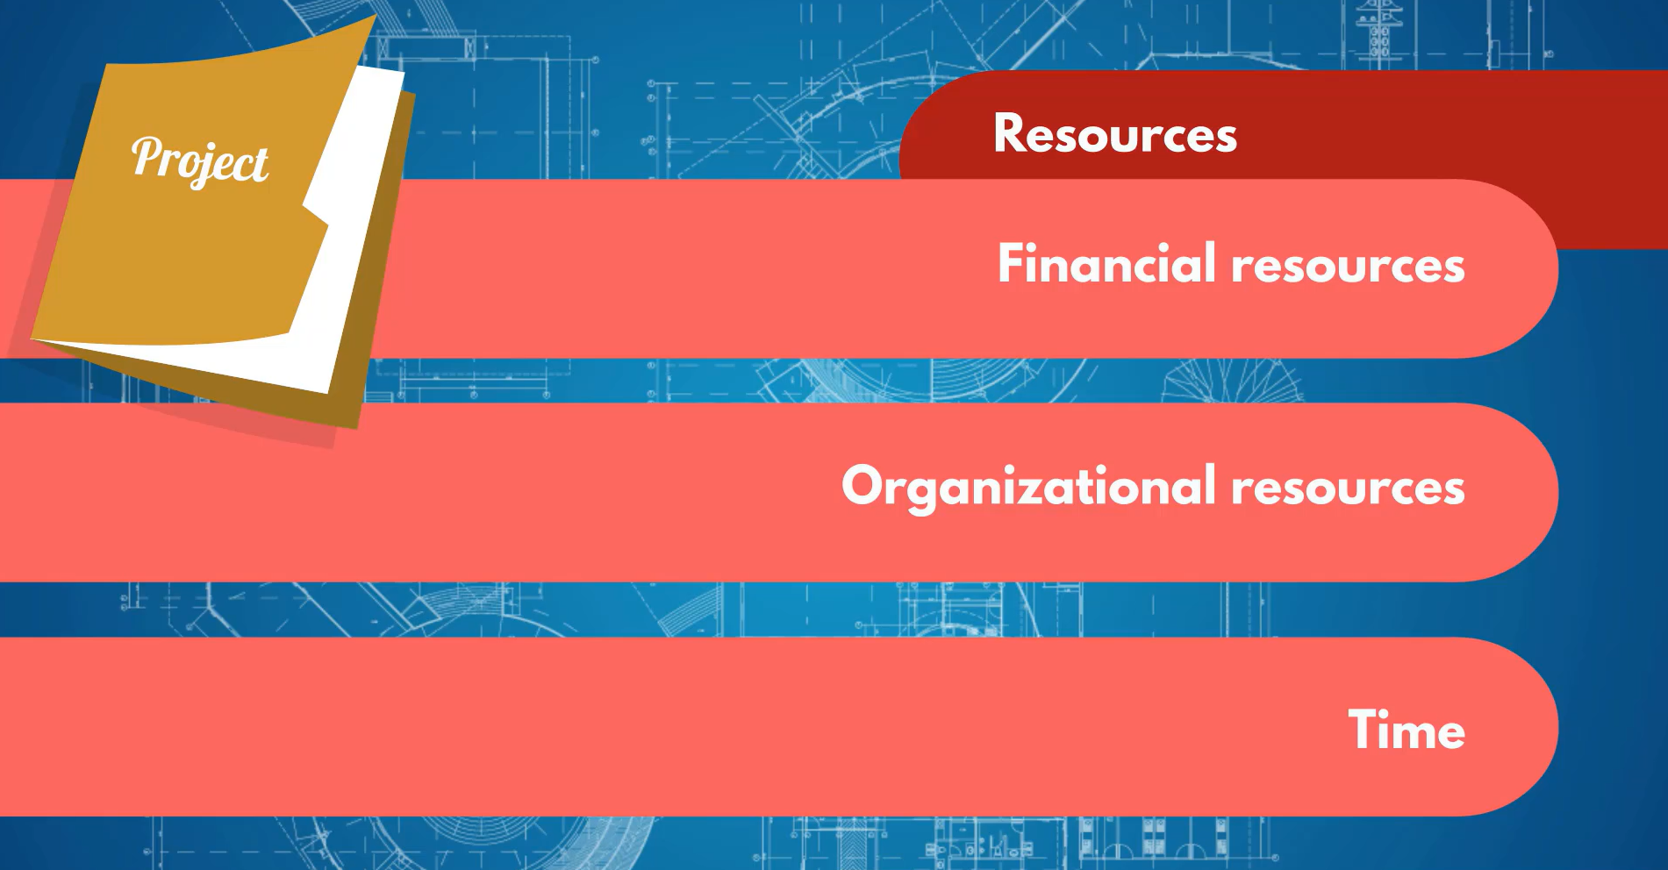

Slide 25
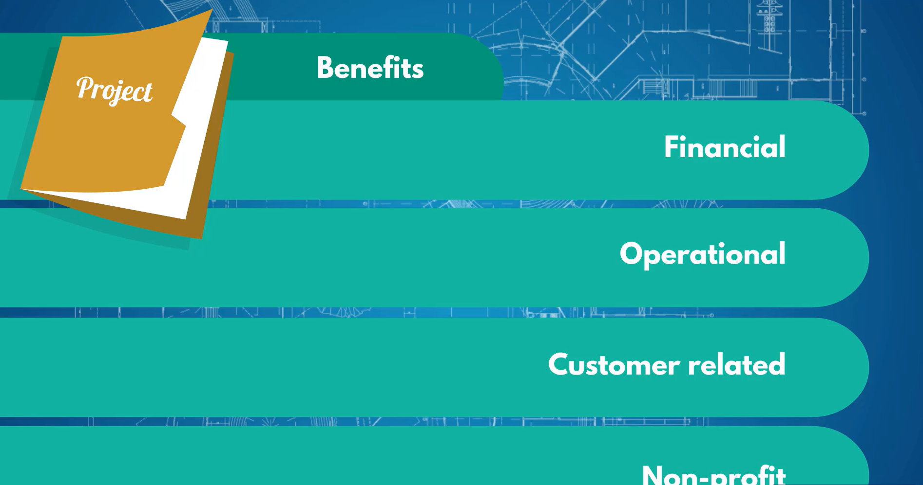

Slide 26
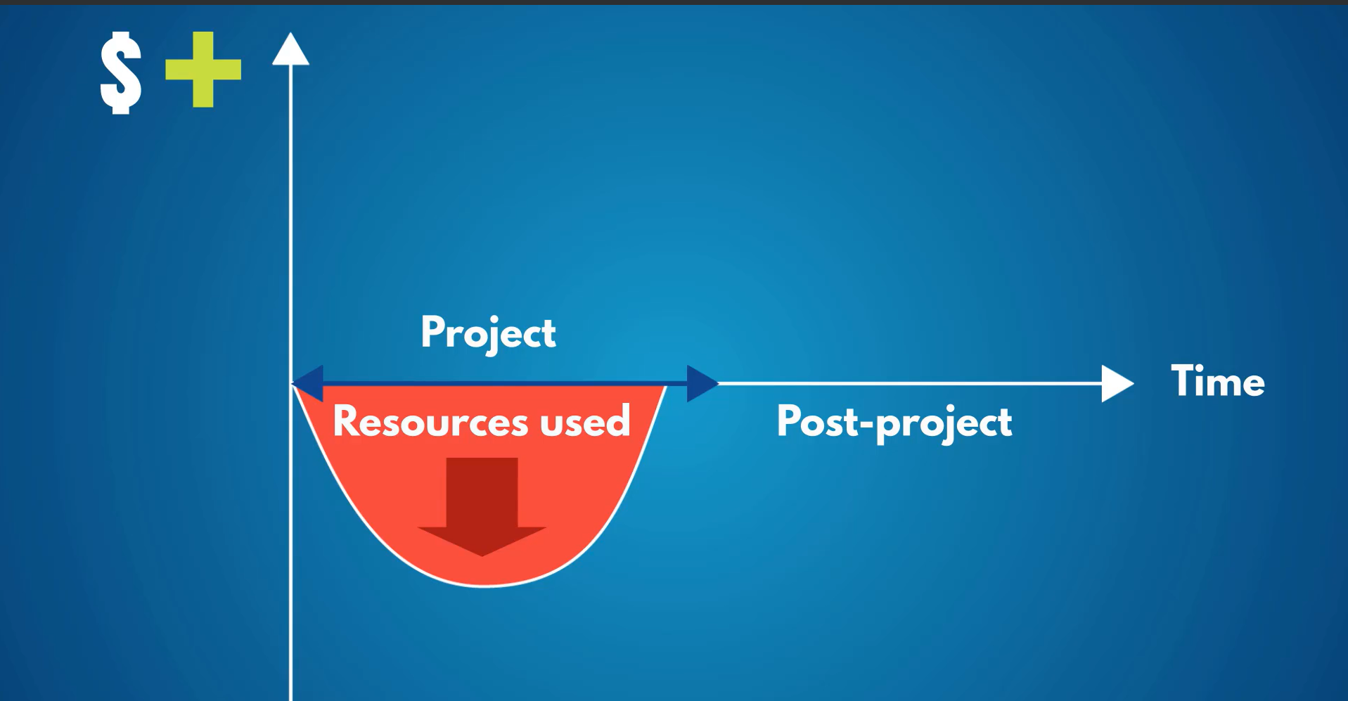

Slide 27
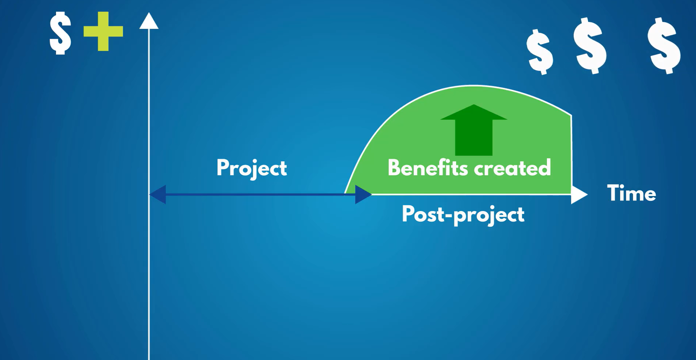

Slide 28
Companies in the software industry execute projects for various reasons, and these reasons can vary based on the specific goals and needs of the company. Here are some common reasons why software companies undertake projects:
New Product Development: Software companies often initiate projects to develop new products or enhance existing ones. This could involve creating innovative software applications, introducing new features, or updating existing software to meet changing market demands.
Market Expansion: Companies may execute projects to expand their presence in the market. This could include developing software for new platforms, targeting new customer segments, or entering new geographic markets.
Technology Upgrades: The rapidly evolving nature of technology necessitates continuous improvement and updates. Software companies may undertake projects to upgrade their technology stack, adopt new programming languages, or migrate to more advanced platforms.
Competitive Edge: Staying competitive in the software industry requires innovation. Companies undertake projects to gain a competitive edge by introducing unique features, improving performance, or offering solutions that differentiate them from competitors.
Customer Requirements: Projects are often initiated to address specific customer needs or requirements. This could involve customizing existing software solutions or developing bespoke software tailored to the unique needs of a particular client.
Regulatory Compliance: Changes in regulations and compliance standards may require software companies to update their products to ensure they meet the latest legal and industry requirements. Projects may be initiated to implement these necessary changes.
Bug Fixing and Maintenance: Ongoing maintenance and bug fixing are crucial for the smooth operation of software. Companies execute projects to address issues, apply patches, and ensure that their software remains reliable and secure.
Efficiency Improvements: Projects can be undertaken to streamline internal processes and improve operational efficiency. This might involve implementing new project management methodologies, adopting DevOps practices, or optimizing workflows.
Cost Reduction: Projects focused on cost reduction aim to identify and implement ways to reduce expenses in software development, such as improving development processes, optimizing resource allocation, or adopting cost-effective technologies.
Strategic Initiatives: Companies often use projects to execute strategic initiatives outlined in their business plans. These initiatives could include entering new markets, forming strategic partnerships, or diversifying product offerings.

Slide 29
